Slide 1
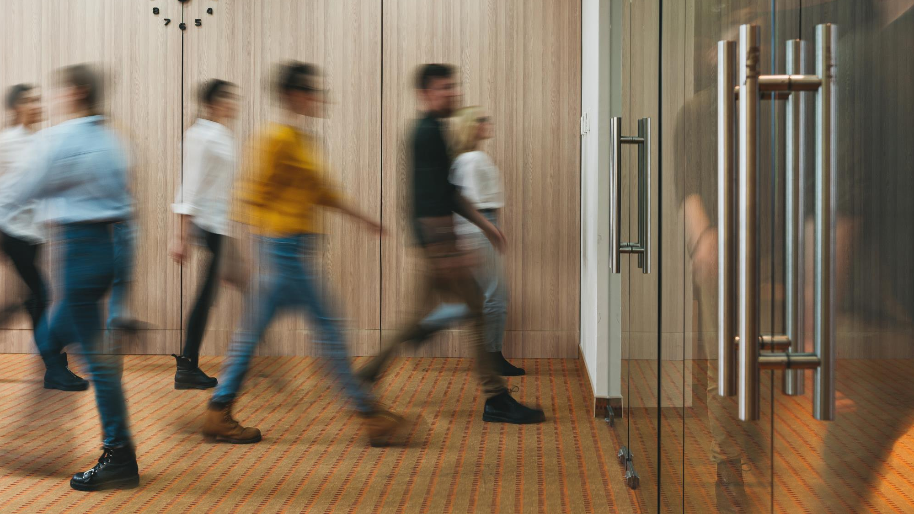
Summer Internship at WSP
Caidyn spickler
DATE 07/31/2024

Slide 2
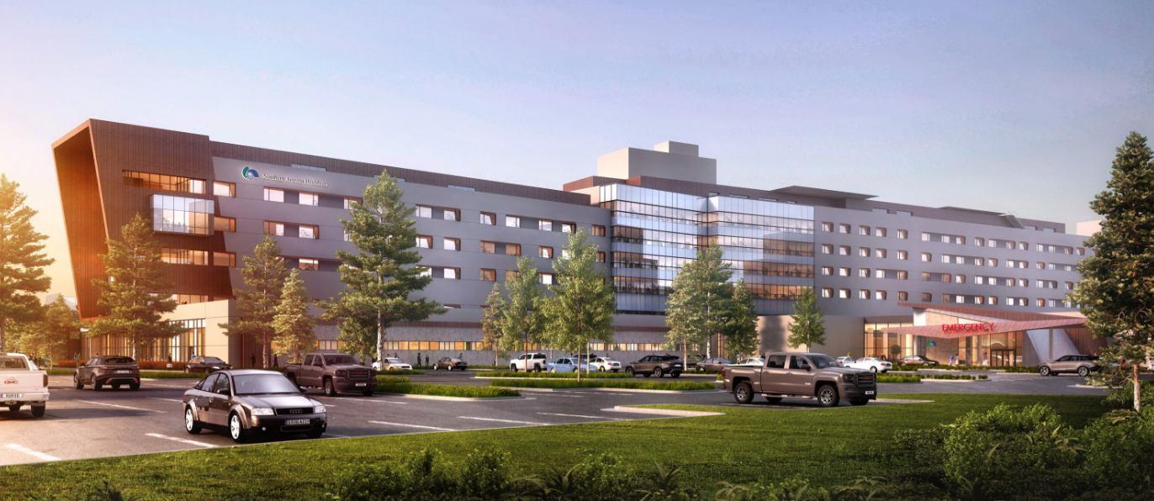
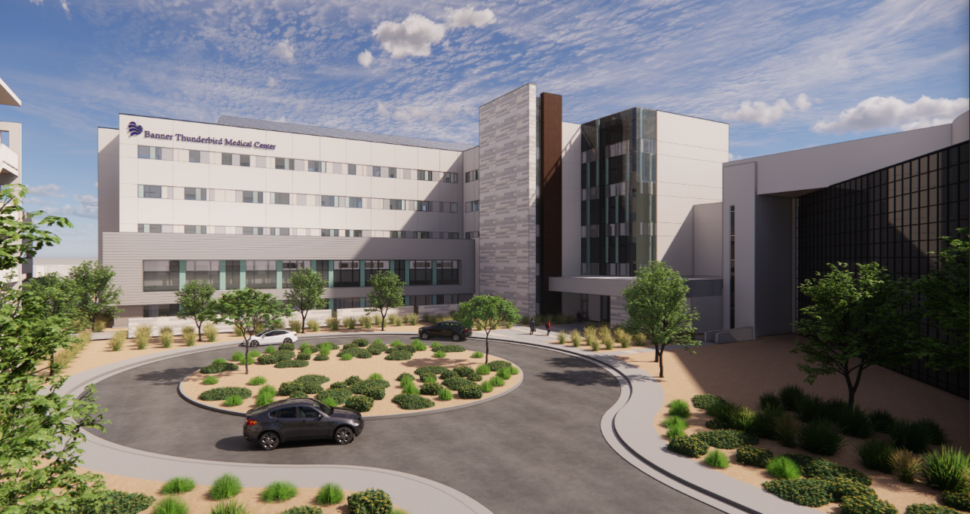
My Role
Electrical Engineering Intern
For The Property and Buildings Group
Tempe Office – Intern Final Presentations
Notes:
Ted

Slide 3
Where I Started
Coming in…
Never worked a professional job
Really young
Not well versed in power
Skeptical about being taught everything I needed to know
Knew I would have to ask a lot of questions
Tempe Office – Intern Final Presentations
Notes:
Like most interns, I had never worked a professional job before.
Unlike Most Interns I was really young. I was only one semester into my sophomore year when I started. So, I doubted if I was ready for this yet.
My job is based around the power side of electrical engineering. There are two main pathways to electrical engineering, power and then the hardware, computer engineering side. My background was a lot more well versed in the computer engineering side.
However, when I met Alex, she expressed that I would not need to worry and that I would be taught everything that I needed to know. While that was extremely exciting for me because I believed that I would be able to do this, I was still skeptical about that. Teaching a job from scratch is hard and tedious on the trainer and because of that, sometimes important things get lost.

Slide 4
What I Learned - Professionally
Communication
It’s ok to ask questions
People want to help you
Let them know where you are
What tasks you have and order of importance
Be yourself
Build stronger connections
Tempe Office – Intern Final Presentations
Notes:
Despite all that, I was excited to learn and try my hand in this position.
I’ve been here for 8 months now and here is what I learned from the professional work environment.
It’s ok to ask questions
- I knew I was going to have a lot of questions.
- I’ve never been afraid to ask a question, but with the amount that I was going to have I was afraid that my colleagues were going to get annoyed
- Everybody is extremely patient and they want to help you learn and grow as an individual so you can effectively be a part of the team
- If you ask questions, you are more prepared for the task and will be less likely to make a mistake
- If you don’t ask questions your colleagues will not know where your understanding lies and will get frustrated when you make a mistake because you didn’t communicate
- I always want to do my best work preferably on the first time around and what worked best for me to achieve that was asking questions
Let them know where you are
- There were some weeks where I would be working on 5 or 6 projects simultaneously
- What worked best for me in staying organized was keeping people updated on where I was and where I wanted to be
- Whenever I got a new project, I would let the person know where I was with my other projects, ask when they wanted my task done and then tell them my plan of action
- I would also let them know where I stood at the end of the day, to keep them updated and know the progress of the task.
Be yourself
- When somebody asks you a question about yourself, go beyond the one-word answers to deepen your connection.
- The experience is a lot more enjoyable when you have friends in the office.

Slide 5
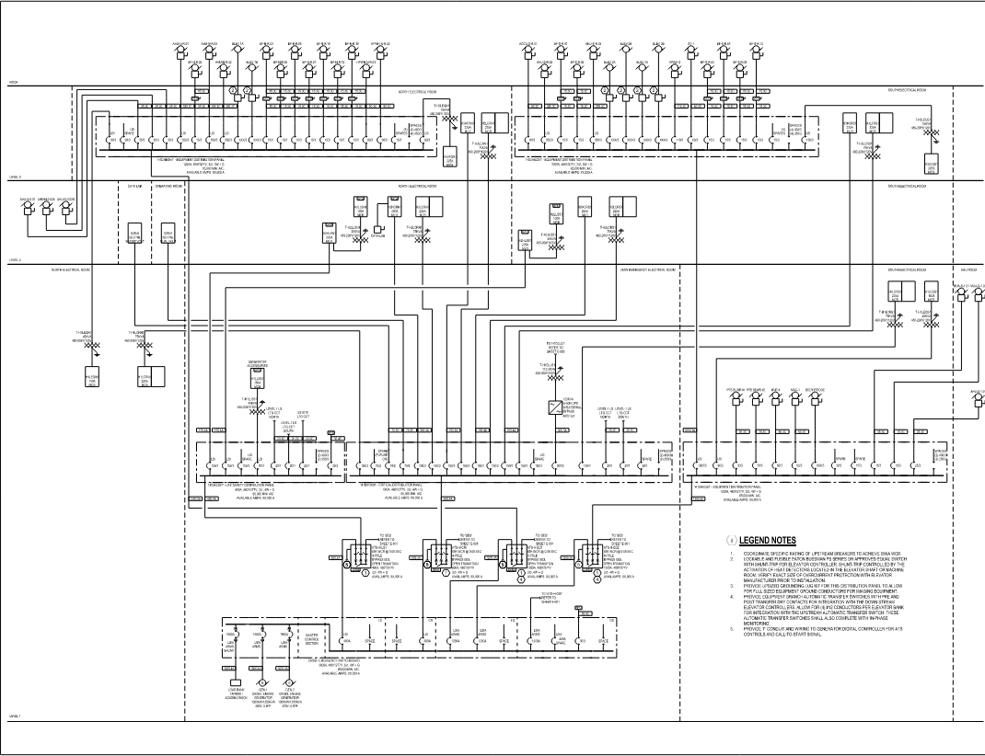
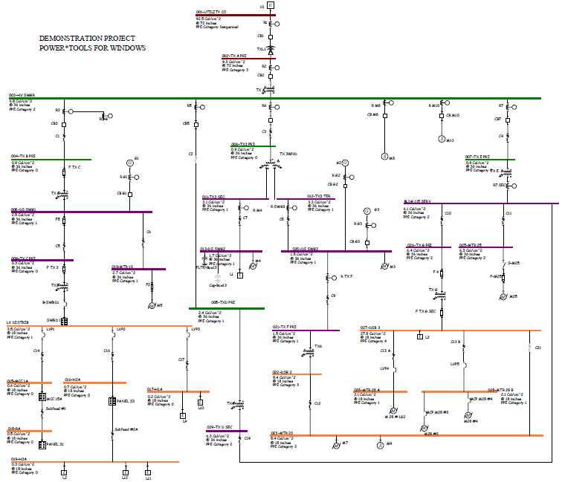
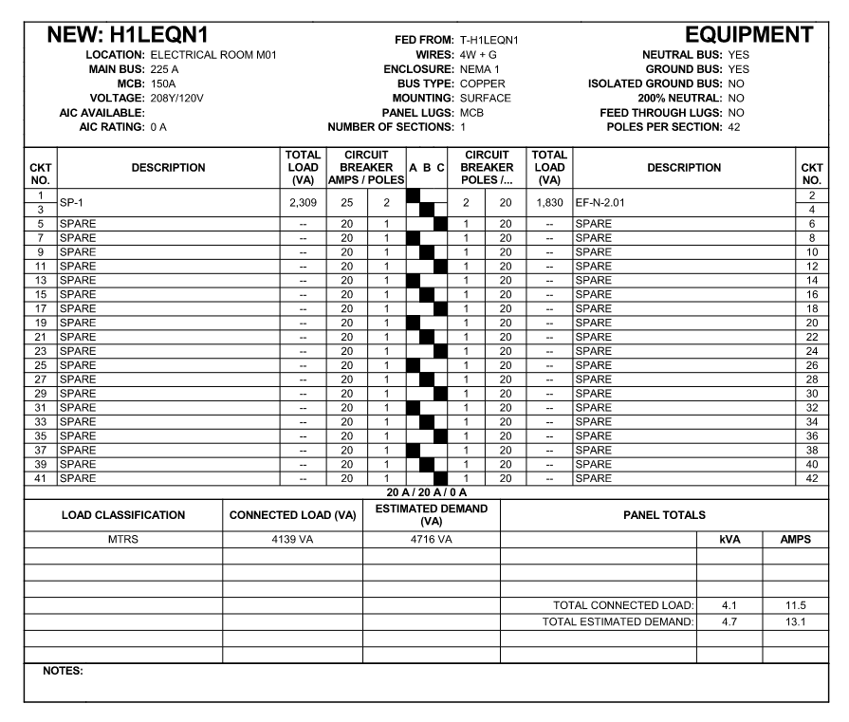
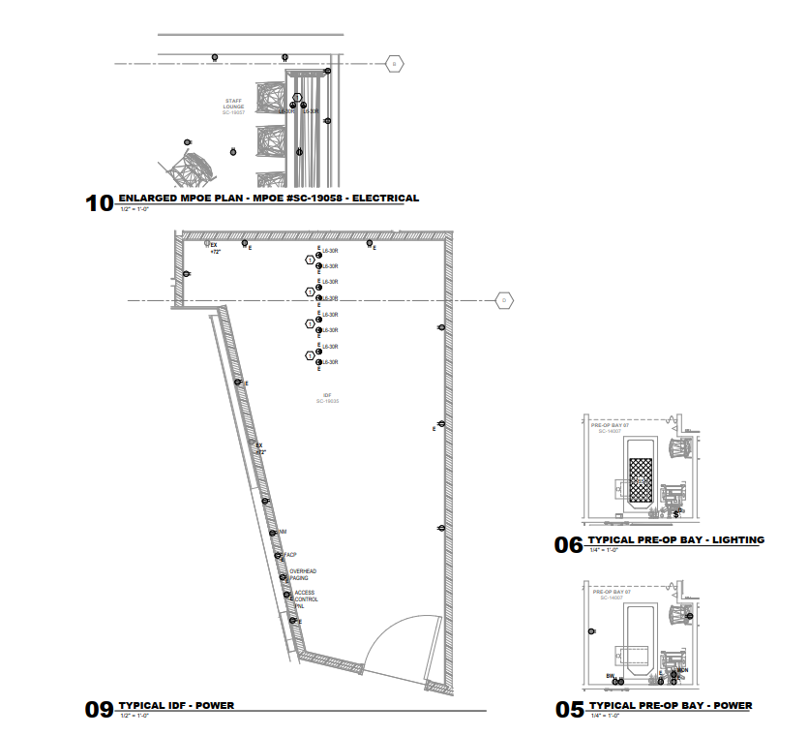
My Tasks
Design Development (DD)
One-Line Diagrams
Placing Devices
Creating Schedules
Creating Views
Populating Rooms
Tempe Office – Intern Final Presentations
Notes:
There a 5 Stages to any project, but my tasks only ever deal with 3 of them.
The first is the Design Development Phase or the DD phase.
During this phase we do these things listed below. It’s a lot of placement and creation. The bigger picture items.
One-lines:
Always our first order of business on a new project. It’s like our map to our power system. It’s Essentially a flow chart
Placing Devices:
We mainly focus on three areas electrically: Power, lighting and Special systems. Sometimes we help with fire safety and technology but we main focus on the first three.
- Power devices include things like receptacles, junction boxes, panel boards etc
- Lighting just encases lighting fixtures, switches and exit signs
- Special Systems devices are things like speakers, data ports, and nurse call devices
Panel Schedules:
Anytime we place a panel we need to create it’s corresponding panel schedule. Once our one-line is complete we use a software called SKM to find the available fault current of each panel. We also create a lighting fixture schedule.
Creating Views:
For certain rooms that are repeated throughout the project, we create enlarged views so that the model does not get crowed. We also create enlarged views for our electrical rooms because that was they are clearer to see.
Populating Rooms:
For existing projects we will populate existing rooms from existing drawings that way we can show what needs to be demoed or what can stay.

Slide 6
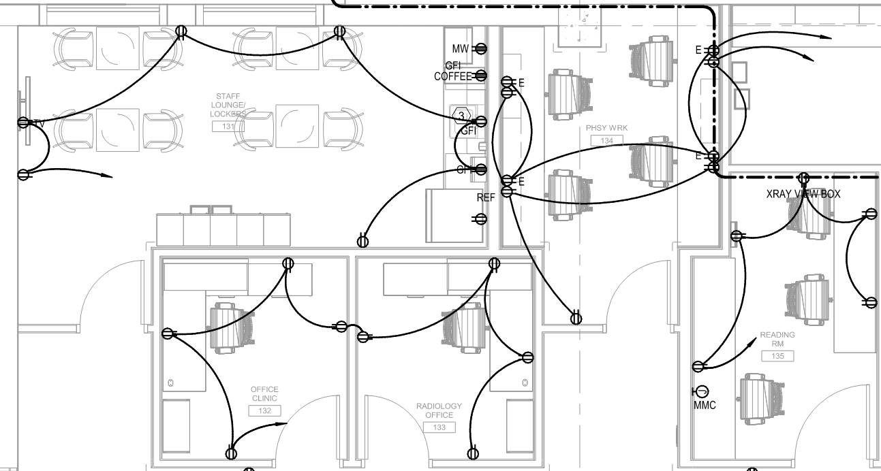
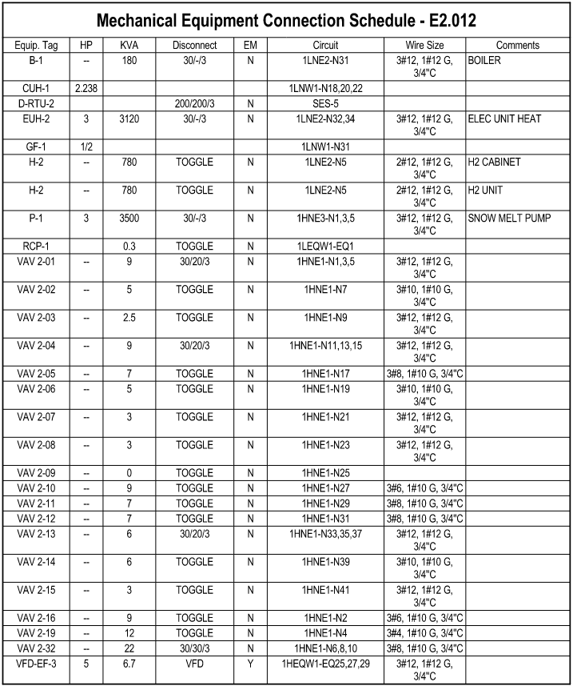
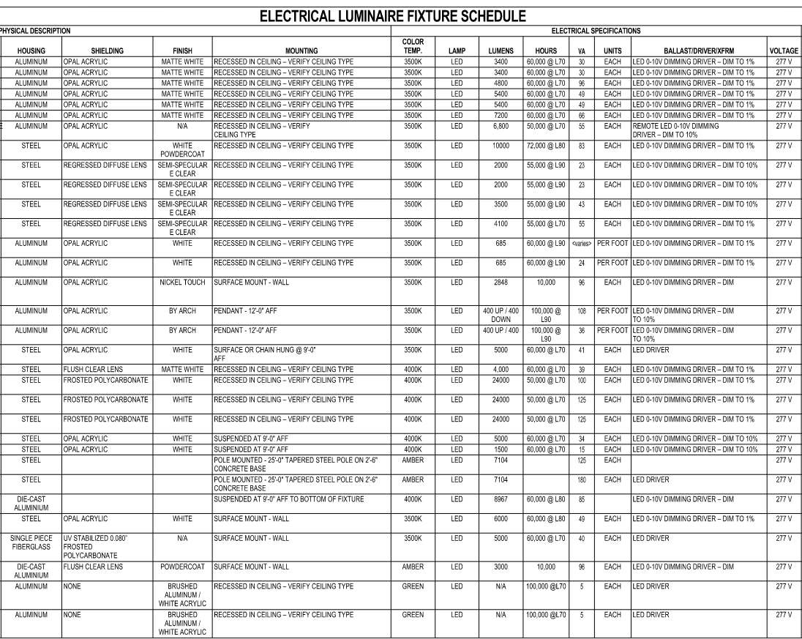
My Tasks
Construction Documents (CDs)
Circuiting
Load Calcs
Filling in Schedules
Mechanical Equipment Connections
Changes to design
Tempe Office – Intern Final Presentations
Notes:
The next phase is our construction documents or CD phase.
This is where we get into the nitty gritty of the job.
There are a lot of NEC restrictions we have to watch out for here. For instance when circuiting rcpt we can only circuit so many rcpts together because we typically use 20A breakers, but code doesn’t allow us to use all 20A so we like to size our loads to be about 80% or less of our CB rating.
We use load calcs for things like disconnect sizing and CB sizing
Whenever we circuit a device or group of devices to a panel, it populates into that panel’s schedule but we have to input the load and CB information. We also have to be purposeful in our naming of the circuit so that a maintenance guy or the contractors can easily identify where and what circuit they are working on.
When mechanical acquires their equipment cutsheet information, they will fill out a mechanical schedule and we use that data, or even the cutsheets sometimes, to create our electrical connections for that equipment. Lots of coordination here.
In the construction documents phase you’re design is supposed to be set, but changes to design are inevitable when in the CD phase because loads could turn out to be larger than expected and we need to upsize a panel or maybe we realized that we overestimated the loads and can remove one, although that is extremely rare.

Slide 7
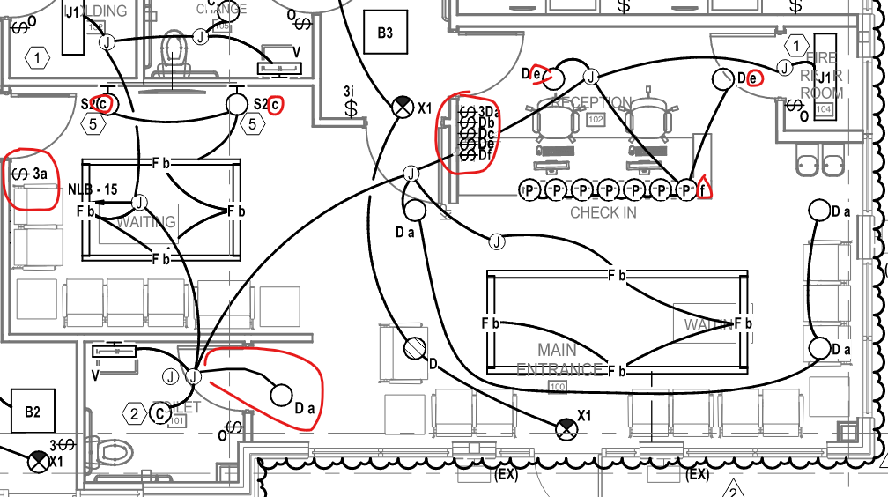
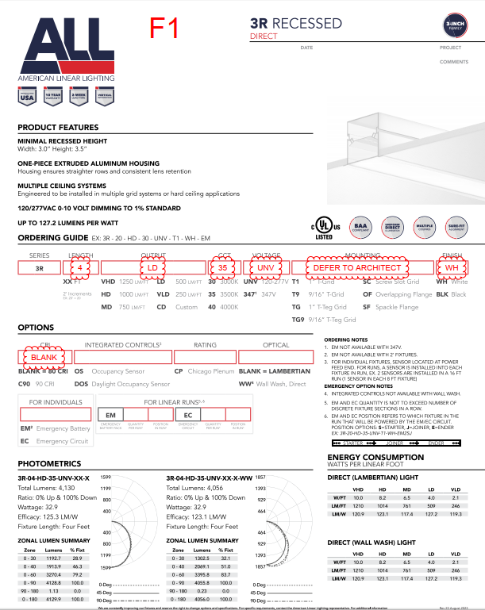
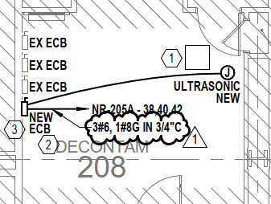
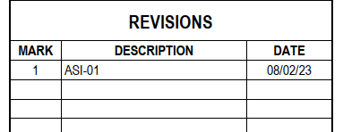
My Tasks
Construction Administration (CA)
Permit Documents
Revisions (RFIs)
Changes to model
Narrative of Changes
Submittals of fixtures
Tempe Office – Intern Final Presentations
DC Office – Intern Lunch and Learn
Notes:
This is the last phase of the project. It starts with permit docs. When we send out our permit docs to the city and sometimes we’ll get city comments and have to make adjustments before we can actually get the permit but once we have the permit we are officially in the CA phase and construction can start.
In the CA phase, the architect or owner will decide that something needs to be changed or they want to change something after a field survey so they can submit what we call and RFI.
From these RFI’s we examine if this change would first be possible and two in our scope of work or budget for our project. If everything checks out, we can make the changes to the model and then create a narrative of those changes to document everything.
Additionally, Contractors will create submittals of devices they plan on buying and we have to check them to make sure they fit with what we specified on the project. If they don’t we create a note saying what was wrong and send it back. There’s a lot to check on these submittals. Once everything is built, we create record docs from the as-built drawings the contractor gave us and then the project is finished!

Slide 8
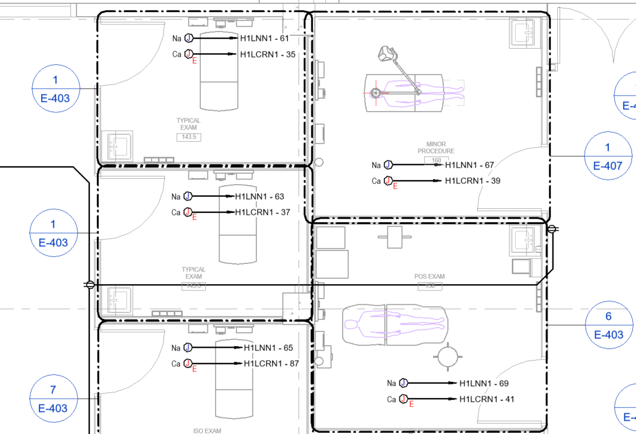
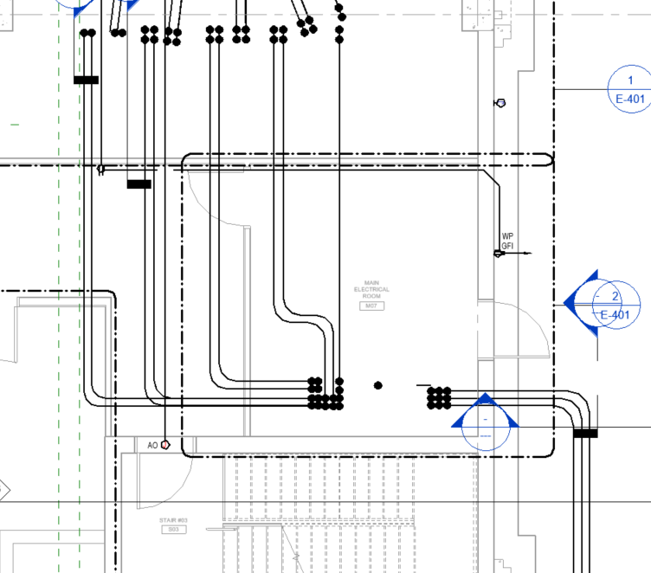
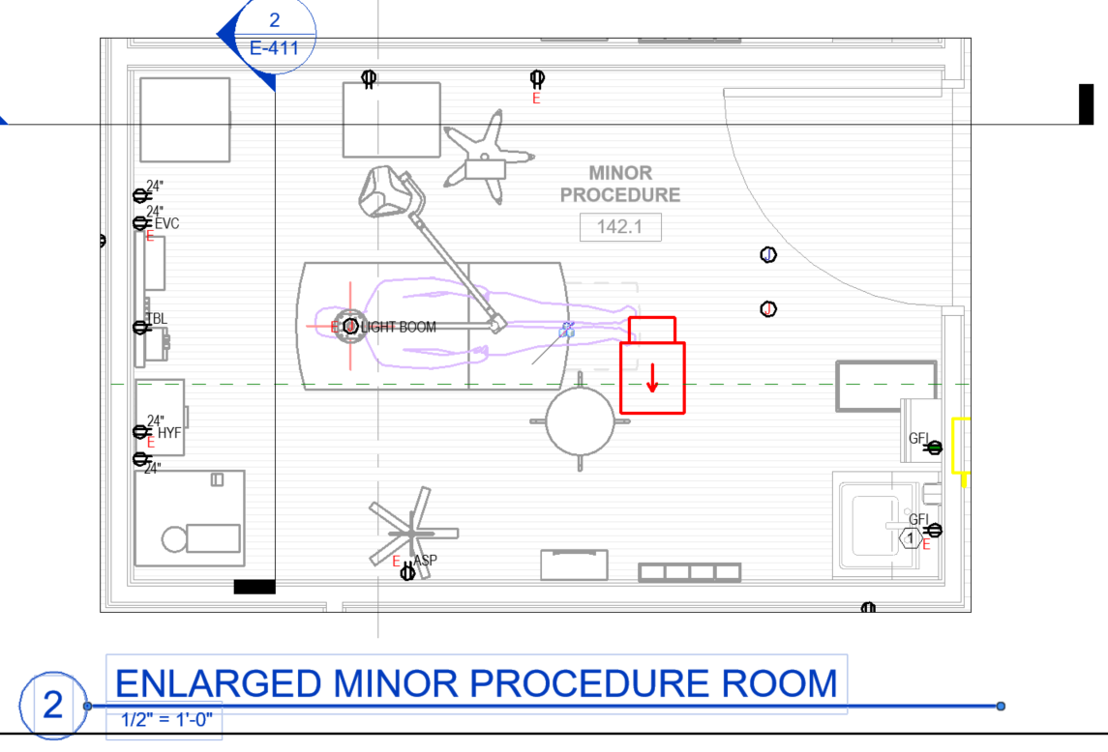
My Tasks
My First Project
American Samoa Specialized Hospital
DD Work
CD Work
CDs go out 9/19!
Tempe Office – Intern Final Presentations
DC Office – Intern Lunch and Learn
8
Notes:
This project is my baby.
I have been working on it ever since I started at WSP back in December. It has come a long way and I have performed a lot of work on it. I’ve done a lot of the work that I specified earlier on this project. It’s a large one and holds a special place in my heart

Slide 9
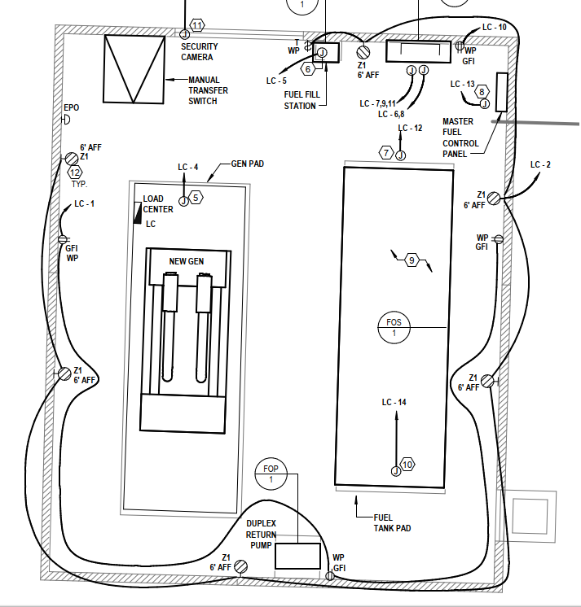
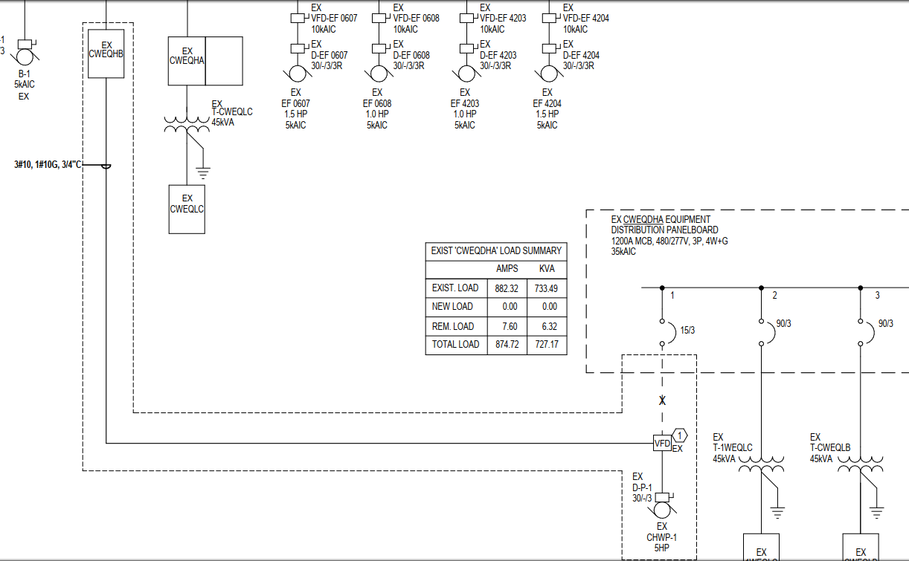
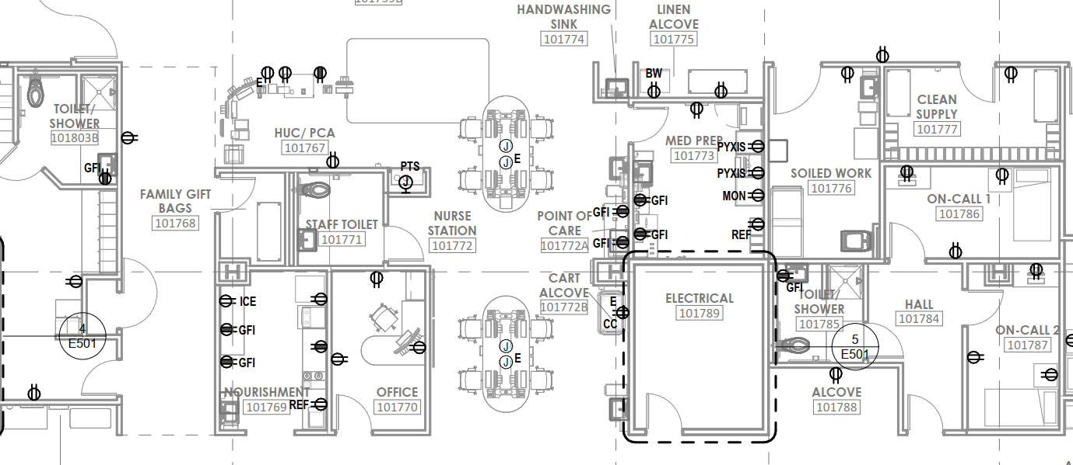
My Tasks
Notable Projects
VVMC Boiler & Gen Replacement
First Permit
Mayo Hospital West CHWP Refeed
The first project that I designed on my own
Mayo MRI Zone 2, Media Center and Lactation
First Site Walk
Banner Thunderbird East Expansion
Current Large project I am working on
One of my favorites
Tempe Office – Intern Final Presentations
DC Office – Intern Lunch and Learn
Notes:
VVMC – Cottonwood project
CHWP – Small project but it was the first one where my name was put as a designer on the project so that was a huge deal for me, I’ll never forget it.
Mayo MRI Zone 2 – First and only Site walk. It was a lot of fun I learned a lot. I enjoy seeing the physical impact our work has on others. It meant a lot to me.
Banner Thunderbird: Most recent project I’ve been trying to work on (IT issues)
Very large project
Just me and my friend Hannah working on it right now and I think we make a really great team
One of my favorites because each floor is specialized so whenever you work on a new floor you are doing a fresh design. Enjoyable

Slide 10
What I Learned
Suggestions for Future Interns
Ask Questions
Be yourself
Be proactive
Stay organized
Take good notes
Document your process and progress
Get good at blue beam
Tempe Office – Intern Final Presentations
DC Office – Intern Lunch and Learn
Notes:
Document your Process and your Progress
- It’s good to know what worked and what didn’t for you so when you either come back next summer or continue your career elsewhere, you can become more efficient, and the job becomes more enjoyable
- I should have taken more pictures and documented more
Blue beam is huge for us at property and buildings and it is my favorite software we use. I’m such a nerd for it that I even tell all my school friends about how much I love it

Slide 11
Special Thanks
All of My Team
Made my time as an intern enjoyable
Alexandra Pearson
Where it all started
Jared Mason
Gave me this opportunity
Scott Mazerolle
Overseed most of my tasks
Conceptual questions
Patient
Hannah Stone
Showed me the ropes
Revit Tricks
Gave me a good chunk of my tasks
Tempe Office – Intern Final Presentations
DC Office – Intern Lunch and Learn
Notes:
Scott – Senior Electrical engineer on the team
- Most of the questions I asked were to him. I know some questions were concerning but despite that he was really patient with me and would explain concepts thoroughly. I really appreciate all that he has done for me while I’ve been here.
Hannah – younger electrical engineer on the team
- remembered what it was like to be an intern so she showed me the ropes.
- She also knows a lot of cool revit tricks and would show me them often. Whenever I had a revit issue she was the first person I would ask.
- She trusted me and gave me a lot of tasks as well. I appreciated her willingness to help me learn and gain experience. Sometimes work was slow but she would always try to help me find something to do.

Slide 12
Thank you!

